Slide 1

Romanian Testing Conference 2018 Report
Ana Prpić, Oradian
Ivana Maleš Galić, Span

Slide 2

We’ll talk about...
Intro
how to travel from Zagreb and Osijek to Cluj-Napoca?
3 days package (2 workshops&conference day)
Selecting the right workshops and sessions&preparing for workshops
Xtestathon = An extreme software testing challenge
Workshops
Application Security
Lectures
The Reality of Testing in an Artificial World
We don’t need more automation engineers!
How Do I Lead an IT Team and Not Go Crazy?
What have we learned from each other?
Did RTC 2018 meet our expectations?

Slide 3




Slide 4
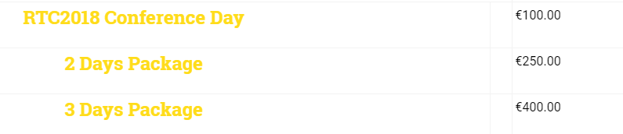
Conference Ticket
Selecting workshops and sessions (https://romaniatesting.ro/program/ ) -> COME PREPARED:
Read, Explore, Google Speakers and research available resources !!!
Preparing for workshops (e.g. https://github.com/angiejones/automation-bookstore )

Slide 5

Web & Android: Application Security Testing for Newbies Workshop by Santosh Tuppad
Let’s start with the first set of slides...

Slide 6

The state of security today
8 out of 10 hospital web apps can be hacked
9 out of 10 wordpress websites pose a security risk
1 in 30 e-commerce sites checkout can be bypassed
IoT on the rise … 80 billion smart devices by 2015.
Whoa! That’s a big number!!!

Slide 7
How would you feel?
If your self-driving car was suddenly in the hands of a malicious hacker?
If your baby’s heart-monitor data was sent to a third party?
If someone were to take over the security cameras/TVs you have installed in your home?
If someone were to break into your home wifi network via a washing machine, and gain access to other devices on the home network?
If someone could get a hold of your complete medical history?
...etc.
Notes:
You get the picture.

Slide 8

What can we do about it?
Notes:
There’s a couple things we can do about it, it’s not completely hopeless.

Slide 9
#1 Use password managers/2FA
e.g. Master Password, KeePass, BitWarden
Strong passwords help shield against traditional password attacks such as dictionary, or brute-force attacks
Don’t reuse passwords across sites!
Activate Two Factor Authentication (2FA) on any services that have it available - assailants may be able to get your password via one of these attacks, but 2FA will help prevent them from logging in and stealing data or taking over your account

Slide 10
#2 Be aware of what you share on social media
Do not disclose which vendors you or your company is using!
Social engineering is definitely a thing!
...plays on human weaknesses to try to manipulate people to get them to do things they don’t normally do (like click a link received from an unknown sender)
...attackers try to direct their targets to visit fake websites, and enter personal information. They also resort to using fake phone calls, or even visits to their targets as part of an attempt to get passwords or other private information that might be exploited to gain access
Over 200,000 new malware samples every day with a further 4,000 ransomware attacks captured per day last year

Slide 11
#3 Read about security
“Hacking For Dummies” by Kevin Beaver
Hacking for dummies cheat sheet (from the book)
“Ghost in the Wires: My Adventures as the World's Most Wanted Hacker” by Kevin Mitnick
“Social Engineering: The Art of Human Hacking” by Christopher Hadnagy

Slide 12
#4 Kick-start your web app security testing
OWASP security testing checklist
OWASP NodeGoat Project
OWASP Juice Shop Project
Hack This Site forum/training ground
Web Application Exploits and Defenses training ground
Challenge #1 Username: testing, Password: ???
Challenge #2 Username: ???, Password: testing

Slide 13
#5 Learn from past examples
A collection of IoT hacking examples
Watch YouTube videos featuring talks by/interviews with Adam 'Major Malfunction' Laurie

Slide 14
#6 Think twice before clicking on a link
Always, always double check the URL before clicking on it and/or entering any login information - it may appear to be from a trusted source, but that source may be compromised or fabricated entirely
Best practice is to manually navigate to a known URL for logging in

Slide 15
#7 Ask the right questions
Are we testing for security?
Is the admin panel or admin login page accessible by anyone on the internet?
Does the User Login have CAPTCHA to stop brute force attacks, but the Admin Login does not?
How private is our domain registration information on who.is? (does it contain email/phone?)
Are test ports open in production?
Do our .apk files contain sensitive information?
What are we doing to avoid XSS attacks? (HTML encoding? JS encoding? DB encoding?)
Why do we trust 3rd-party services we integrate with?
etc.

Slide 16
The Reality of Testing in an Artificial World by Angie Jones http://angiejones.tech/ PPT: slides

Slide 17
Our world is changing...
Artificial intelligence is being employed in nearly every walk of life, from virtual assistants to self-driving cars.
? How will this new way of life impact software testing?
? What will be our role?
? Will there even be a need for software testers?
? What skills will testers need to know for testing AI-based technologies?
Notes:
You get the picture.

Slide 18
The Future of Testing...
Machine learning won't necessarily eliminate testing jobs, but it will change how the work gets done.
~Paul Merrill
We believe that the most important solution to overcome increasing testing challenges will be the emerging introduction of machine-based intelligence.
~2016-17 World Quality Report
We'll see a trend where humans will have less and less mechanical dirty work to do with implementing, executing, and analyzing test results but they will still be an integral and necessary part of the test process to approve and act on the findings.
~Moshe Milman & Adam Carmi
Notes:
You get the picture.

Slide 19
When talking about AI in testing community...
most of the discussion has been on how AI tools will be able to help us as a Testers
There are a lot of new automation tools that are popping up and promising that AI will save the day and that's all right
Going beyond conversations about tools => discussing how to test forms of AI that are present today in today's applications such as machine learning
Notes:
You get the picture.

Slide 20
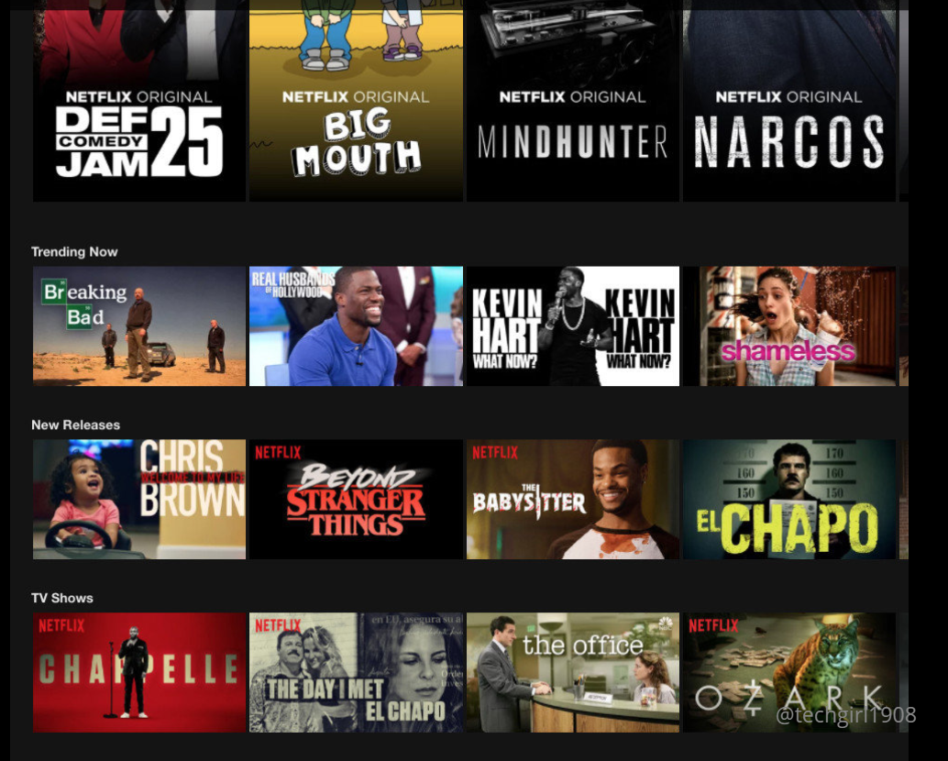
#Example: Netflix, Twitter
Q1: How to test this?
Q2: How to say if it’s correctly filtered?
Q3: How to tell if something is a bug?
Notes:
You get the picture.

Slide 21
#Example: Netflix, Twitter
How to test an application where it's core functionality is -> it has machine learning.
Netflix has its recommendation system: when you go to your opening page on Netflix the recommendations there are based on you personally -> that is also based on machine learning algorithms.
At Twitter there are features there that are employing machine learning. How to test if something is a spam?
Ask yourself...
Why do we look at AI, machine learning, as it is something that's way out in the future and not necessarily something we have to work on right now or think about right now.
Notes:
You get the picture.

Slide 22
Be ready, Get involved!
A lot of people will say there is no need to test machine learning features
What is Angie Jones advice?
„We should definitely be involved in this because people look at machine learning and AI concepts.
This black box that is always right, is just correct by default. And there have been horrific stories in the media where that is not the case.”
Notes:
You get the picture.

Slide 23
Machine etics
http://angiejones.tech/wp-content/uploads/2018/03/The_ethics_of_self-driving_cars_-_Paul_Fenwick.mp4
Notes:
You get the picture.

Slide 24
Expect the unexpected...
What is your input for testing AI, ML app?
You expect your app to work better as time goes on – IT LEARNS!
What are the challenges in our guidelines for testing and automation?
we often say that in order to test such an order for it to be testable the exact results must be known in advance and especially for automation.
when you think about writing automation script you have this scenario in mind and you have an expected result and you need to assert on an expected result.
Problem?
in machine learning there is no exactness there is no preciseness. There's a range of possibilities that are valid and that could be correct.
Notes:
You get the picture.

Slide 25
What can we do?
Don't allow others to make you believe that AI and machine learning is this all-knowing black box. As testers we know better!
Get involved!
Read up more about what machine learning actually is
Look at different applications that are used in machine learning and start thinking about even if you don't work on them right now.
Ask yourself - How would I test this?
First step is to just start thinking about what would your test strategy be on something like a Netflix recommendations page or Twitters timeline of tweets, for example, like how would you test this.
Notes:
You get the picture.

Slide 26
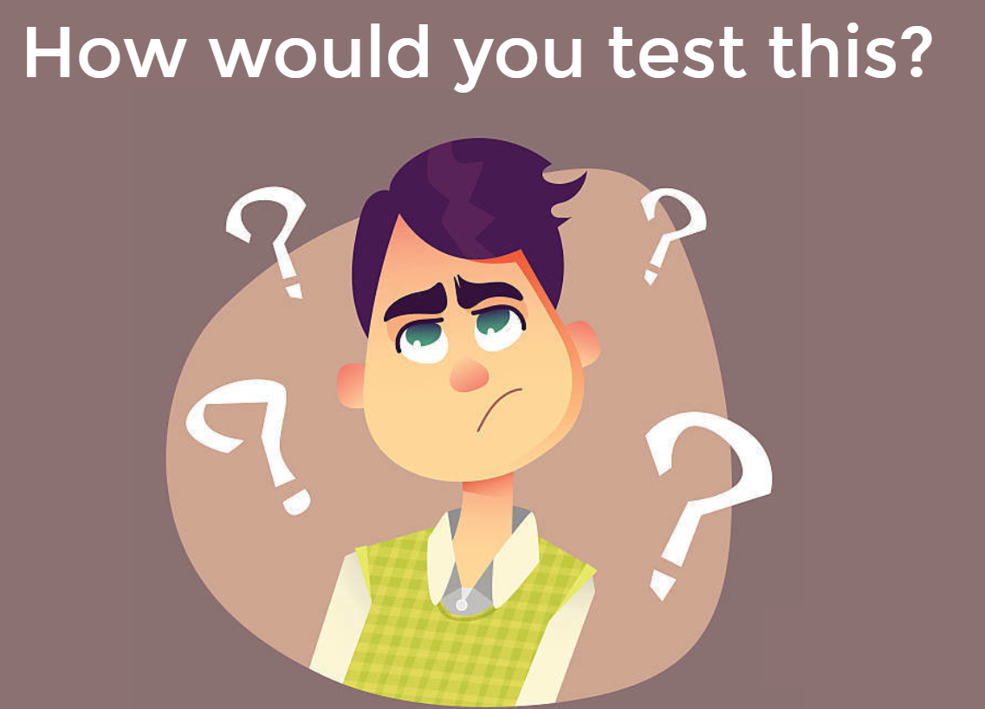
Notes:
You get the picture.

Slide 27

#1 Learn how it learns
There is no exact
RIGHT or WRONG answer

Slide 28

#2 Train the system
If the system hasn’t learned anything yet, it would randomly offer advertisements.
What would I like this system to learn?
e.g. Men like pants, women like dresses?

Slide 29
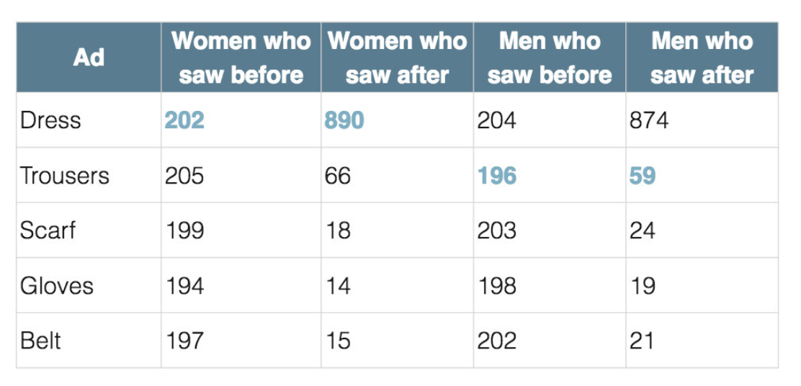

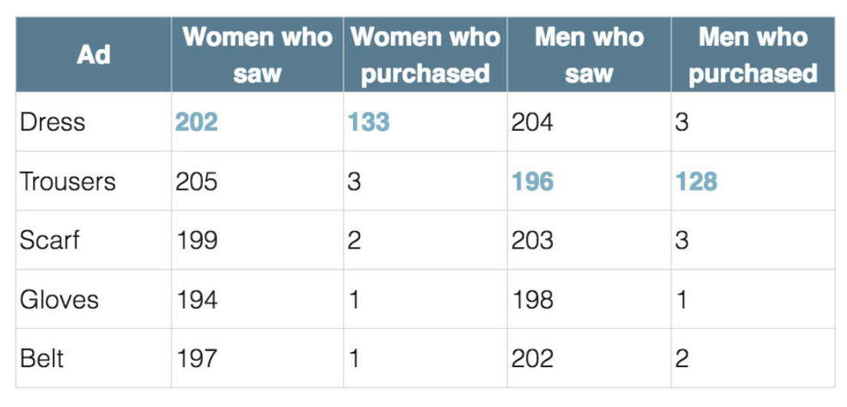
#2 Train the system

Slide 30
#2 Train the system
What was the problem?
= System displayed adds with products which sold most to all customers!!
Solution?
#1 Throw models!
#2 Give system more data – TO LEARN!

Slide 31
#3 Prove the Findings
As technology advances, so must our test approaches
Challenge your thoughts and beliefs
The need for automation became more apparent

Slide 32
We don’t need more automation engineers by Bas Dijkstra

Slide 33

About the author
Worked in automation for 12 years
For the first 7-8 wrote some horrible, inefficient & invaluable, plain rubbish automation!
...he realised this only years after
He sees a lot of automation engineers still falling into the same trap; as if we as an industry are not moving forward

Slide 34
What do you mean, we’re not moving forward?!
Let’s look at some of the questions on SO:
I'm super new to automation., what tool/language should I start learning?
How can I automate my API testing with Selenium?
How can I retry my failing tests automatically?
I want to create a new super cool shiny keyword-data-driven hybrid multiplatform AI-powered test framework, preferably running on blockchain, help me!
etc.
The common denominator to all these? Everything is centered around the tools, tools, tools...
Notes:
You get the picture.

Slide 35
In other words, there’s a lot of questions concerning the 'how?' of automation, where asking 'why?' and 'what?' first would have been a much better approach
Notes:
You get the picture.

Slide 36
Q: How to improve?
A: Fix automation training!
Notes:
You get the picture.

Slide 37
Automation training should focus on (1):
Software testing
Automation isn’t some end goal in and by itself - it’s an activity that supports testing
To do that, you need a solid grasp of what testing is, and how it’s done
Software development
Creating automation === creating software! [needs to be reliable, maintainable & efficient]
Automation awareness
Awareness about what automation can and can’t do, and the ability to communicate that to your stakeholders
Notes:
You get the picture.

Slide 38
Automation training should focus on (2):
Automation patterns
Learn to recognize and apply generic patterns, independent of tools
e.g. recognize when to automate against the UI vs. against an API of a web application
Tools
of course, tools are important - just not the most important thing
Notes:
You get the picture.

Slide 39
Key takeaways
Stop focusing relentlessly on tools
Share your experiences with others [blog, podcast, meetups, conferences]
Don’t be afraid to confront people saying 100% automation is the goal, or that anyone can automate anything - especially if that person is a tool vendor
For every automation task, ask yourself : “Why” and “What”
Notes:
You get the picture.

Slide 40
We need BETTER ones!
And then more of those
It’s not true we don’t need any more automation engineers...

Slide 41
Read more
Test automation: start with the 'why?‘
We don't need more automation engineers!
Notes:
You get the picture.

Slide 42
How Do I Lead an IT Team and Not Go Crazy? By Jim Holmes PPT: slides Book: The Leadership Journey

Slide 43
STEP1: Answer 3 Qs
Do I Want To Be A Leader?
How To Be A Leader?
Why Become A Leader?

Slide 44
STEP2: What’s in it for me?
Self-fulfillment
Fill a need
Helping someone to grow has many rewards
We have too few good leaders!

Slide 45
STEP3: What makes a great leader?
Protects team
Mentor
Knows the mission
Inspires
Solves problems
Focused
Calm
Delegates
You get respect by giving respect!

Slide 46
STEP4: Growing into leadership
Deal with yout fears (e.g. I’ll lose my technical skills! -> YES, MAYBE, DEAL WITH IT)
Mentor and broaden your skills
Move your skills up to business level

Slide 47
I don’t have the tech skills to lead a team¨!-> YES, MAYBE, DEAL WITH IT)
Do you actually need them?
Know how to find answers!
Your team is strong!
Remember your strengths
Ask for more responsibility!
Improve your communication
Good communication is about them, not you

Slide 48
From zero to hero
Manage expectations (Up&Down)
Flip negatives to positives (Think of value)
Foster success
Safe to fail
Manage your team
Deal with difficult people

Slide 49
Wait 10 minutes!
Dealing With Angry, Trollish, or Rude Emails
TAKE A BREAK:
Don’t be upset, angry, emotional – walk away from the keyboard, go outside, you don’t need to respond immediately
1: erase everyone in TO, CC fields to avoid sending the email you don’t want to send
2: delete message
3: write new mail

Slide 50
Pushing for change
Know who to pitch to
Know culture around experimenting
Improve predictability (not speed)
Better hiring, better retention

Slide 51
Don’t forget: Take care of yourself
Get a mentor – NOW
Become a time management super hero
Work/Life balance is not a myth

Slide 52
Find your Leader style
Praise in public – Criticize in private
Mentor your team
Delegate responsibility
Expect – don’t just empower
Open your door
Learn to say NO

Slide 53

And in the END..
? What have we learned from each other?
? Did RTC 2018 met our expectations?

Slide 54

VISIT TESTBASH
USE TWITTER
FIND A MENTOR
READ ARTICLES
How to stay calm in an incredibly stressful situation!
PREPARE FOR CONF. DAY – CHOOSE YOUR SESSIONS
WISELY
WHO TO FOLLOW FROM QA WORLD?
(LINKEDIN, TWITTER)

Slide 55

Conference Buddy
Conference Buddy wants to provide a place to find companions for tech conferences. You can look for one or more person with whom you can attend a conference together. Support each other, find a familiar face between all these strangers. You will feel more at ease and comfortable just knowing you’re not alone. At the same time you’ll help others to feel better!
http://www.conferencebuddy.io/

Slide 56

Thanks!
Any questions?
You can find us at:
aprpic@gmail.com / @a_prpic
ivana.malesgalic@span.eu

